Slide 1
Rolling Guidance Normal Filter

Slide 2
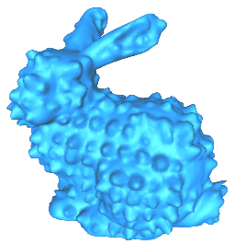
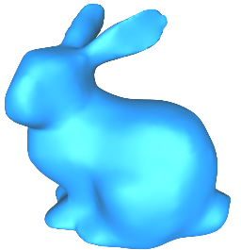
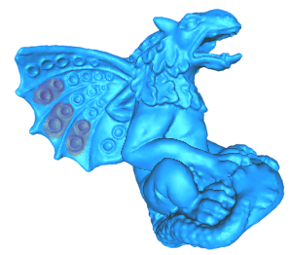
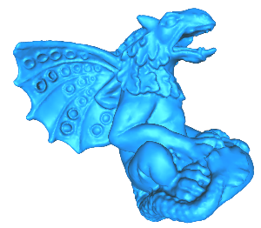
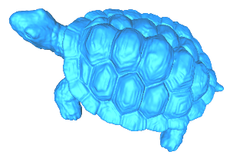
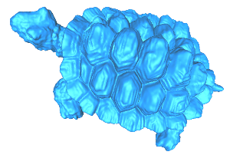
Overview
Geometry texture removal
removing small scale features
preserving large scale structures
Geometry texture editing
transforming embossed geometry to engraved geometry and vice versa
support global/local editing
Geometry texture removal
Global editing
Local editing

Slide 3
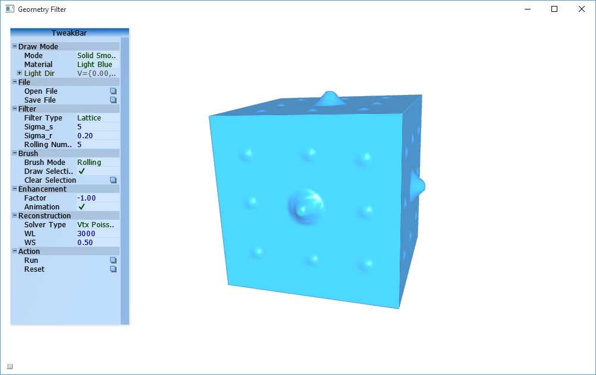
Load 3D models
Load 3D models
Click “Open File” button
Supported file formats:
*.obj;*.off;*.ply;*.stl
Mouse events
Left button: rotate
Right button: translate
Middle button: scale

Slide 4
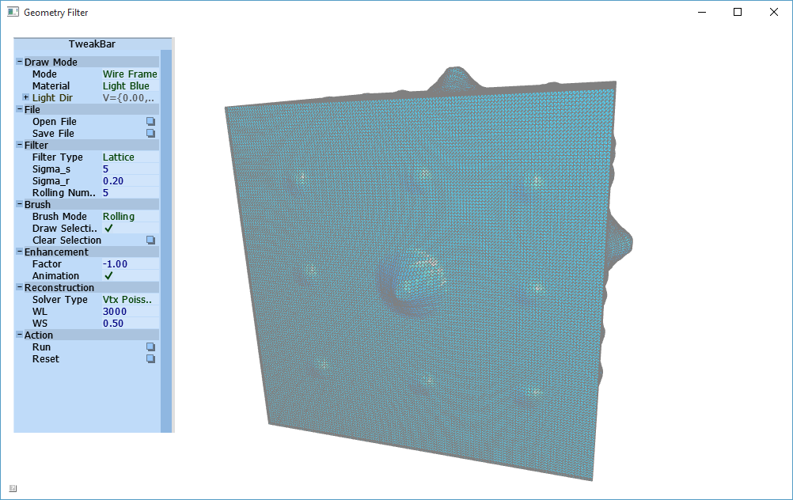

Geometry texture removal
Suppose that one wants to remove all geometry features whose scale is smaller than the yellow circle.
1. Change mode to “Wire Frame”
Estimate the radius of the yellow
circle as $15∗{\overline{l}}_{e}$
Here ${\overline{l}}_{e}$ is the average edge length
2. Set Sigma_s to 15
3. Click the button Run

Slide 5
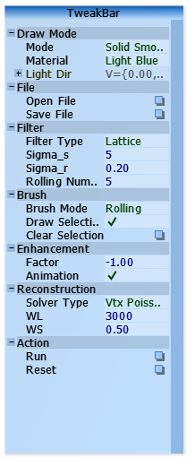
Geometry texture removal
Sigma_r
Increasing its value gradually increases the smoothness of final results
Larger Sigma_r results in smoother output

Slide 6
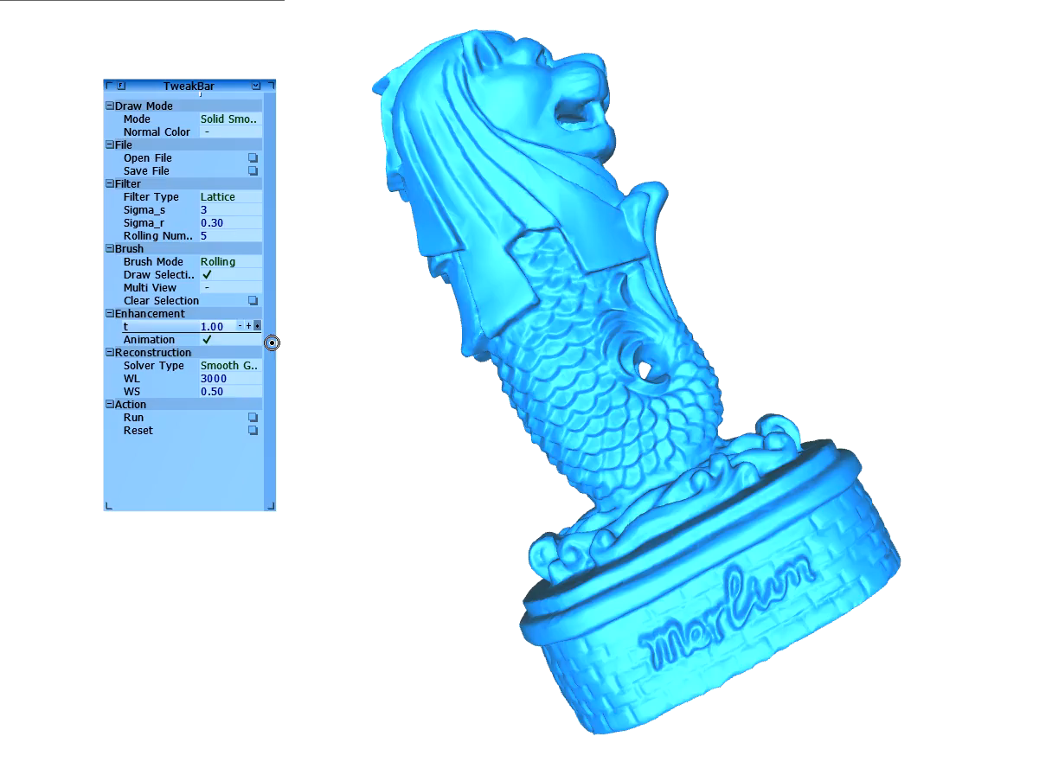
Geometry texture editing
Global editing
Interactively geometry texture editing
by changing parameter t

Slide 7
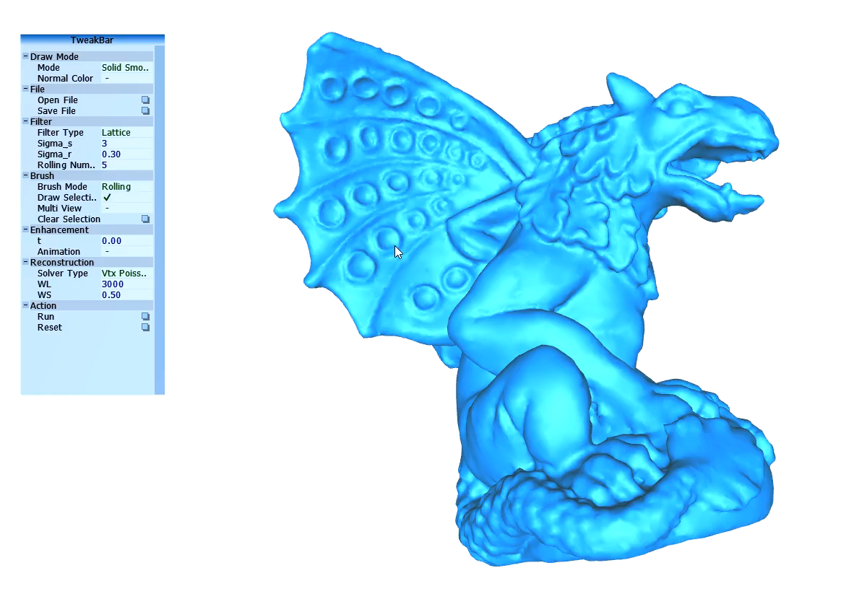
Geometry texture editing
Local editing
Set Animation to false
Select : CTRL + Left button
Exaggerate features
Remove features
Engrave features

Slide 8
Reference and Dependencies
Reference
Rolling Guidance Normal Filter for Geometric Processing
External Libs
OpenMesh, Eigen, Freeglut, ANN, AntTweakBar

